Slide 1


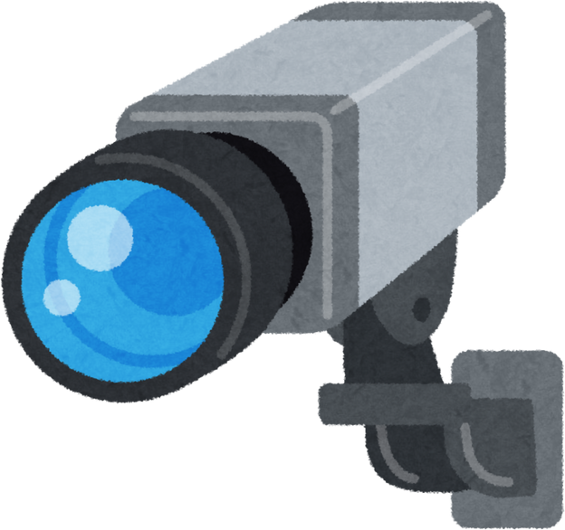
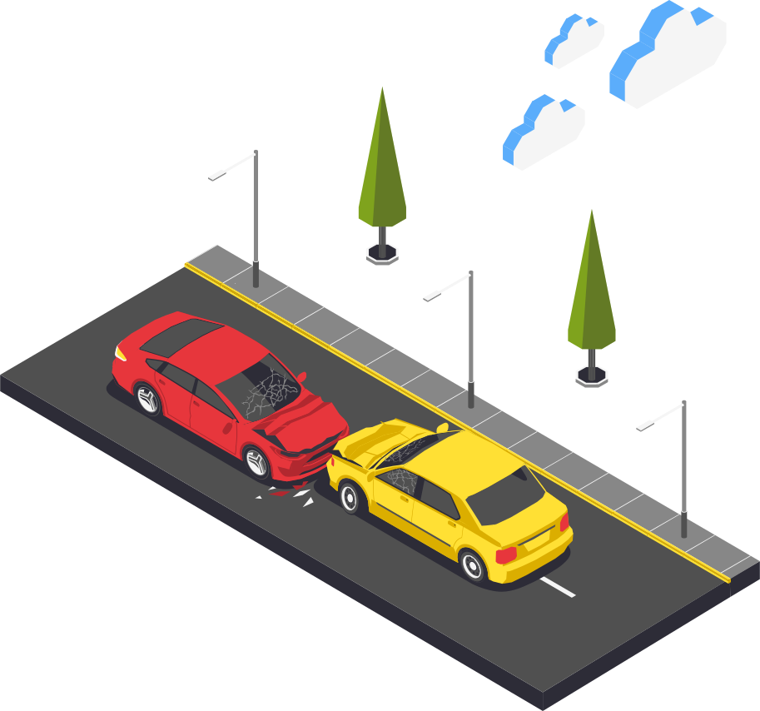

AI Based System For Real-Time Accident Severity Detection
VISION
Nora Alshahrani
Nada Alotaibi
Amal Alqahtani
Lana Alasim

Slide 2
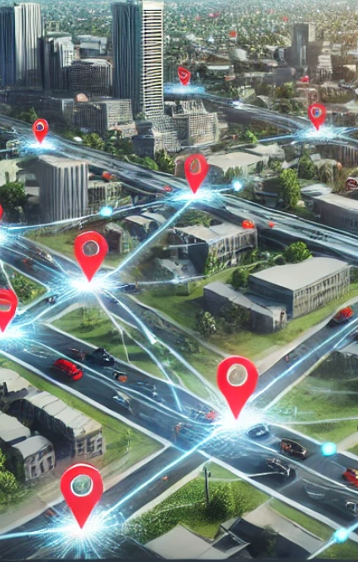
PROBLEM STATEMENT
Delays in detecting and responding to traffic accidents slow emergency response times and increase the risk.
SOLUTION
Develop a real-time traffic accident detection system using street cameras and AI technology. The system will employ YOLOv8 to automatically detect and classify accidents into three severity levels: mild, moderate, and severe. Additionally, it will identify damaged vehicles and fallen individuals for comprehensive incident reporting.

Slide 3
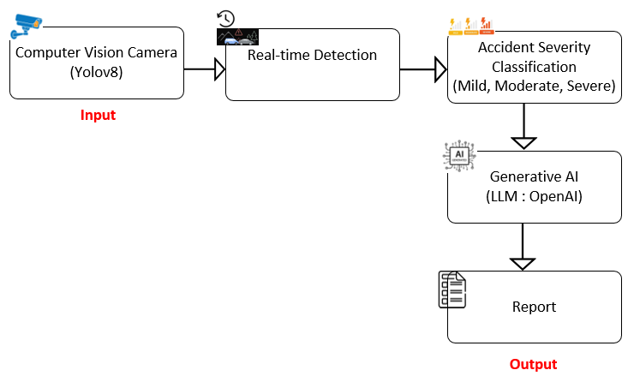
SOLUTION ARCHITECT

Slide 4


VISION 2030
Traffic Safety Improvement
Advanced Technologies
Economic Growth
"نحن نعيش في عصر الثورة الصناعية الرابعة، وهي ثورة تعتمد على التكنولوجيا والبيانات، وإذا لم نواكب هذه الثورة، سنتأخر كثيرًا عن العالم"

Slide 5
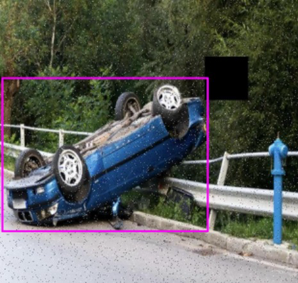
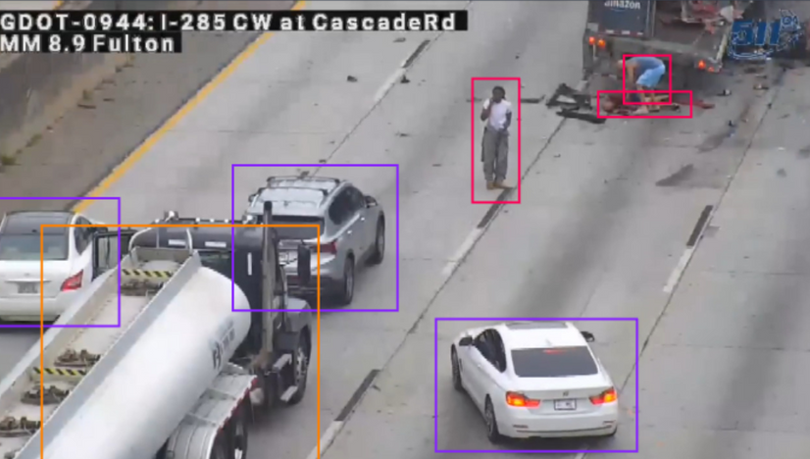
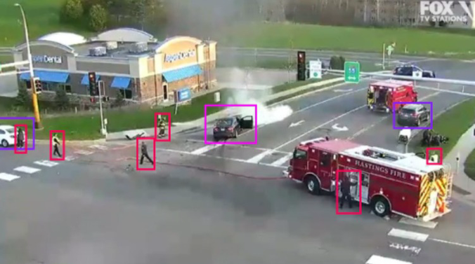
DATA
Dataset Source
Roboflow: Accident Severity Dataset
YouTube: Accident Videos
Data Preparation
Data Augmentation: such as Greyscale, Noise, Blur, Cutout and Brightness.
Data Annotation: Labeled images for object detection and classification.
Dataset Overview
Total Images: 8,221
Classes: 3 (Mild, Moderate, Severe)

Slide 6


MODELS
YOLOv8 ( Pre-trained Model, Fine-tuning ) : Object of interest: Accidents, Cars, Trucks and People
Generative AI (OpenAI): Report Generation

Slide 7
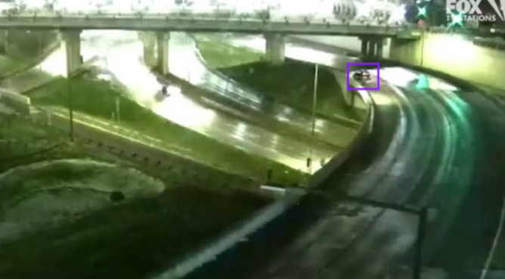
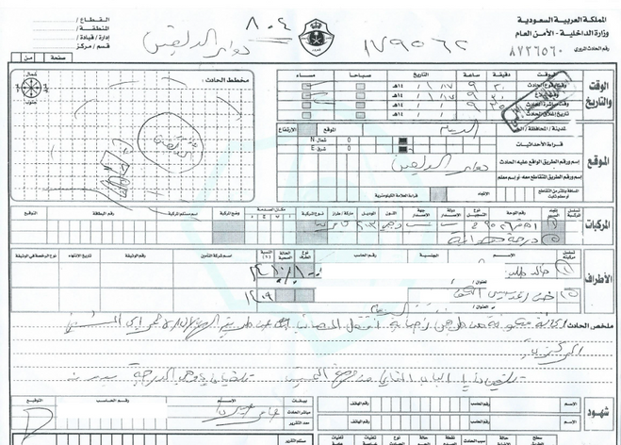
CHALLENGES
Lack of local data
Image quality
Difficulty in training a model on all the detailed information in a Najm report

Slide 8
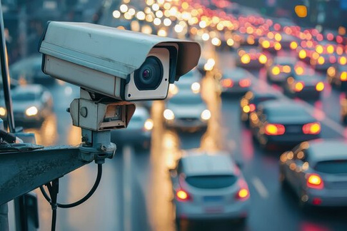




APPLICATION ON SCALE
Smart city traffic surveillance camera system
Highways Between Cities
Integration with Emergency services
Public Events

Slide 9


FUTURE WORK
Driver Notification System
Dashboard (Statistics of Accidents)
Fine tune the model on all the detailed information in a Najm report

Slide 10
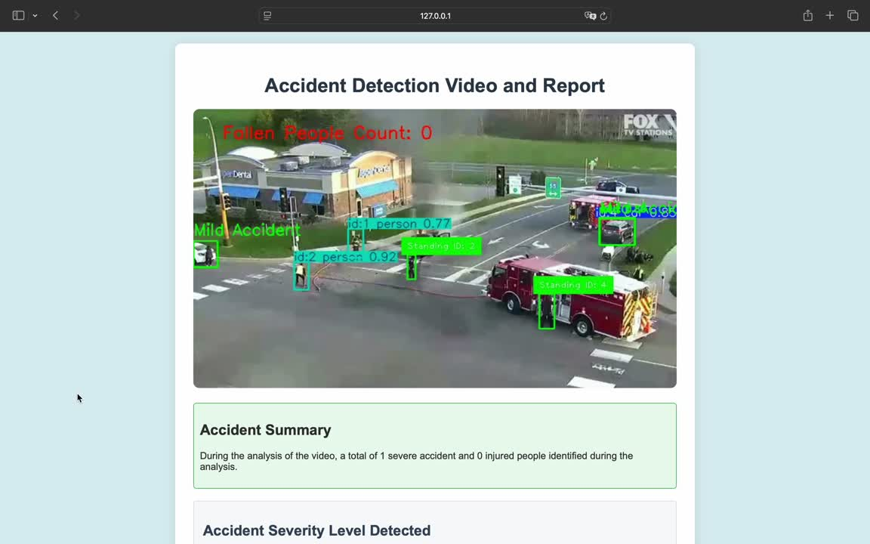
DEMO

